Slide 1
Fitting the Smile

Slide 2
Introduction
Industry standard optimization algorithm: Levenberg-Marquardt
It is a local optimization algorithm
Advantage: Fast
Disadvantage: May get stuck in local minima

Slide 3
Introduction
We can choose initial parameters to mitigate the disadvantages and amplify the advantages.
Initial parameters close to the final solution will increase speed of the algorithm and reduce the risk of it finging a local minimum along the way.

Slide 4


Levenberg Marquat Algorithm
Gradient descent
Gauss Newton
$h=c J^{⊺}W(f − \hat{f})$
${[J}^{⊺}WJ]h=J^{⊺}W(f − \hat{f})$
$${[J}^{⊺}WJ+λ I]h=J^{⊺}W(f − \hat{f})$$
Marquat’s update relationship

Slide 5

Levenberg Marquat Algorithm
${[J}^{⊺}WJ+λ I]h=J^{⊺}W(f − \hat{f})$
In our case $W=I$, since we don’t have access to the measurments errors nor the covariance matrix.
And so:
$[H+λ I]h=J (f − \hat{f})$

Slide 6
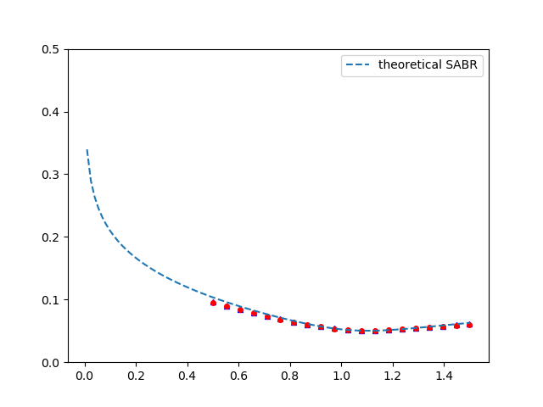
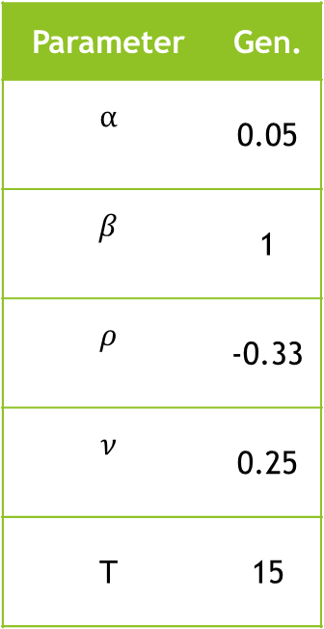


Levenberg Marquat Algorithm
Parameter | Gen.
$$α$$ | 0.05
$$β$$ | 1
$$ρ$$ | -0.33
$$ν$$ | 0.25
T | 15
European call
European put
Volatility ($σ$)
Normalized Strike ($\frac{K}{f_{0}}$)

Slide 7
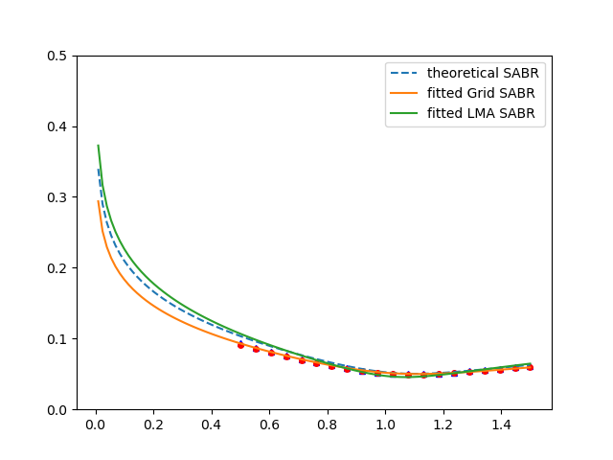
Levenberg Marquat Algorithm
Parameter | Gen.
$$α$$ | 0.05
$$β$$ | 1
$$ρ$$ | -0.33
$$ν$$ | 0.25
T | 15
European call
European put
Volatility ($σ$)
Normalized Strike ($\frac{K}{f_{0}}$)

Slide 8
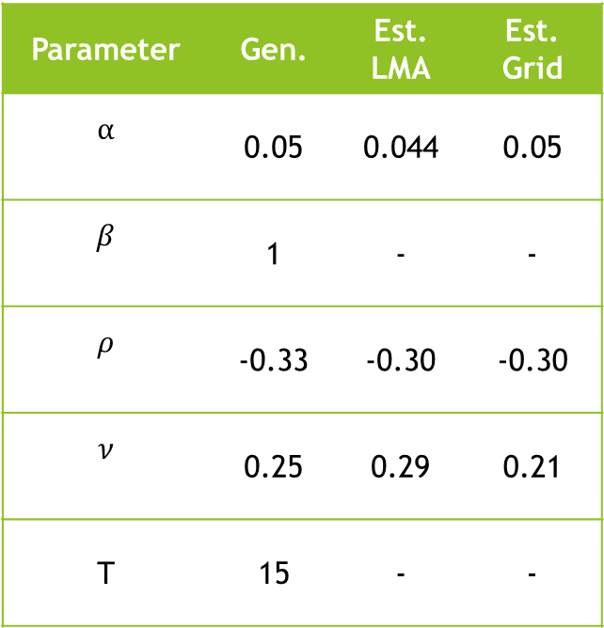
Levenberg Marquat Algorithm
Parameter | Gen. | Est. LMA | Est. Grid
$$α$$ | 0.05 | 0.044 | 0.05
$$β$$ | 1 | - | -
$$ρ$$ | -0.33 | -0.30 | -0.30
$$ν$$ | 0.25 | 0.29 | 0.21
T | 15 | - | -
European call
European put
Volatility ($σ$)
Normalized Strike ($\frac{K}{f_{0}}$)

Slide 9
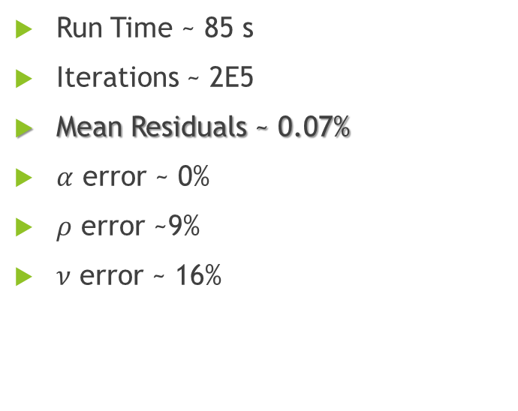
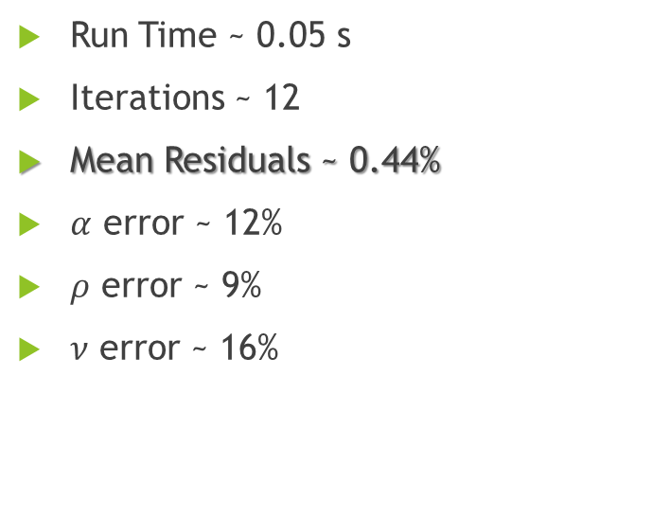
Levenberg Marquat Algorithm vs Grid Performance
LMA
Grid
Run Time ~ 0.05 s
Iterations ~ 12
Mean Residuals ~ 0.44%
$α$ error ~ 12%
$ρ$ error ~ 9%
$ν$ error ~ 16%
Run Time ~ 85 s
Iterations ~ 2E5
Mean Residuals ~ 0.07%
$α$ error ~ 0%
$ρ$ error ~9%
$ν$ error ~ 16%

Slide 10
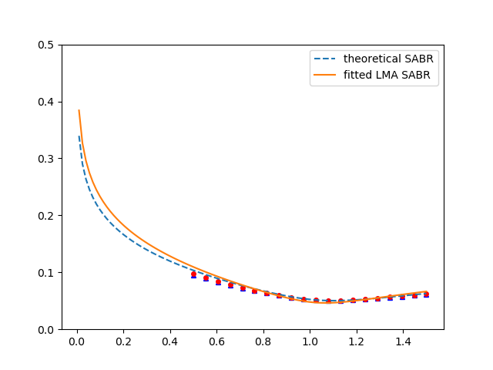

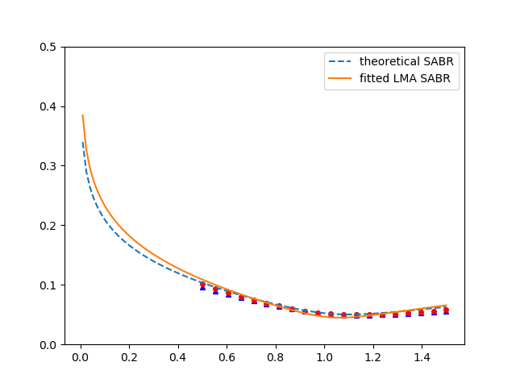
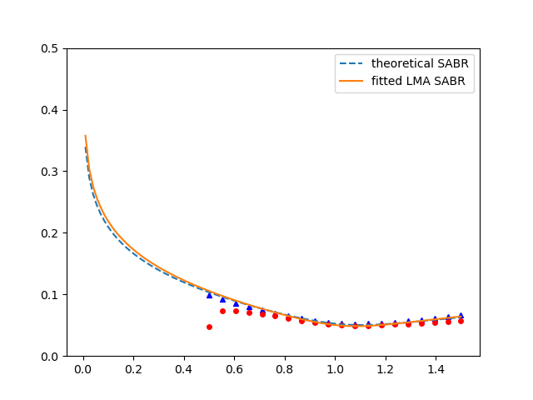
…more examples

Slide 11
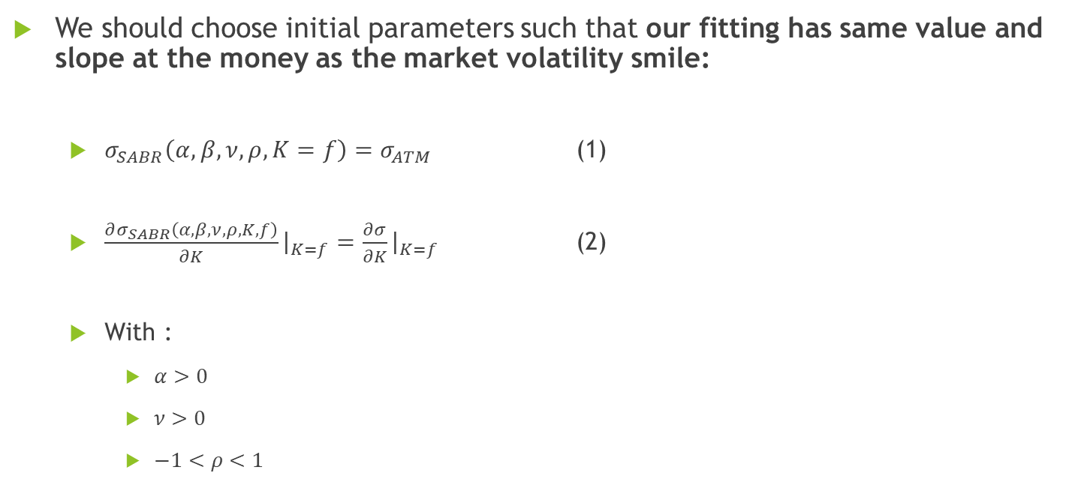
Smart parameters
We should choose initial parameters such that our fitting has same value and slope at the money as the market volatility smile:
$σ_{SABR}\left(α, β,ν, ρ, K=f\right)=σ_{ATM}$ (1)
$\frac{∂σ_{SABR}\left(α, β,ν, ρ, K, f\right)}{∂K}{\left.​\right|}_{K=f}=\frac{∂σ}{∂K}{\left.​\right|}_{K=f}$ (2)
With :
$α>0$
$ν>0$
$−1<ρ<1$

Slide 12
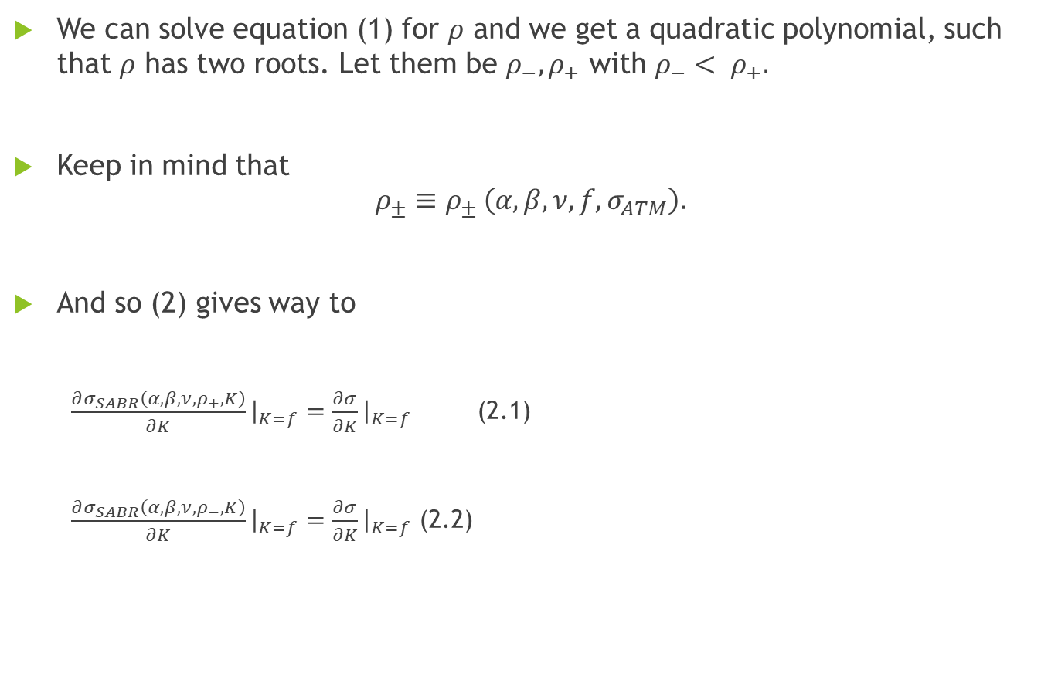
We can solve equation (1) for $ρ$ and we get a quadratic polynomial, such that $ρ$ has two roots. Let them be $ρ_{−}, ρ_{+}$ with $ρ_{−}< ρ_{+}.$
Keep in mind that
$$ρ_{±}≡ρ_{± }\left(α, β, ν, f, σ_{ATM}\right).$$
And so (2) gives way to
$\frac{∂σ_{SABR}\left(α, β,ν, ρ_{+}, K\right)}{∂K}{\left.​\right|}_{K=f}=\frac{∂σ}{∂K}{\left.​\right|}_{K=f}$ (2.1)
$\frac{∂σ_{SABR}\left(α, β,ν, ρ_{−}, K\right)}{∂K}{\left.​\right|}_{K=f}=\frac{∂σ}{∂K}{\left.​\right|}_{K=f}$ (2.2)

Slide 13
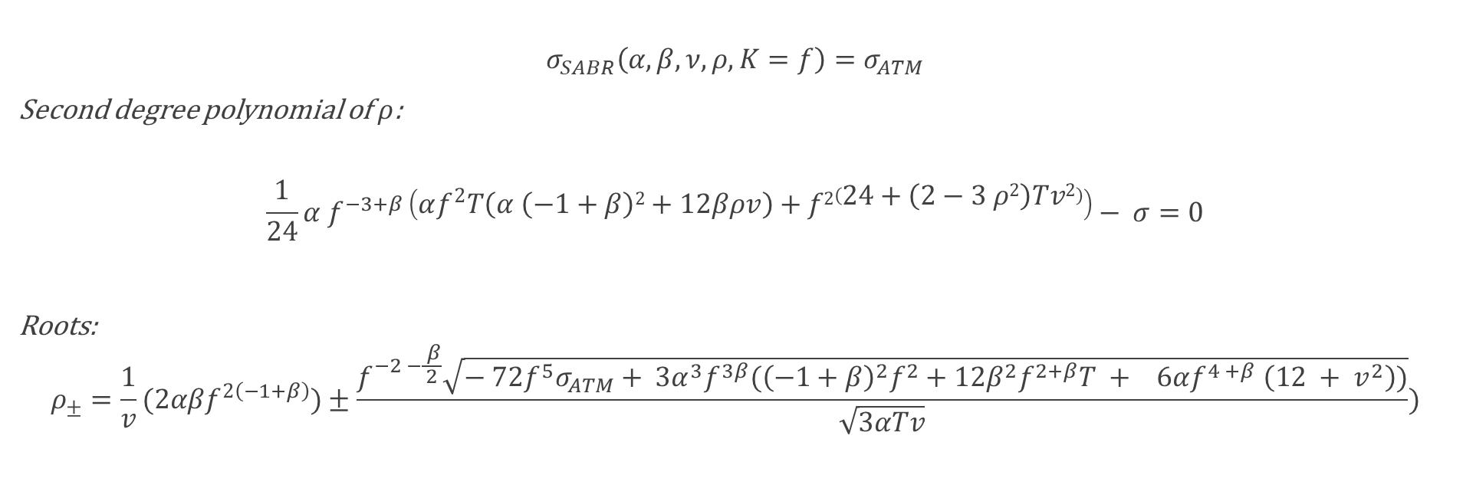

Smart Parameters: $ρ$
$$σ_{SABR}\left(α, β,ν, ρ, K=f\right)=σ_{ATM}$$
Second degree polynomial of $ρ$:
$$\frac{1}{24}α f^{−3+β}\left(αf^{2}T\left(α \left(−1+β\right)2+12βρv\right)+f2\left(24+\left(2−3 ρ2\right)Tv2\right)\right)− σ=0$$
Roots:
$$ρ_{±}=\frac{1}{v}(2αβf^{2\left(−1+β\right)})±\frac{f^{−2 −\frac{ β}{2}}\sqrt{− 72f^{5}σ_{ATM}+ {3α}^{3}f^{3β}({\left(−1+β\right)}^{2}f^{2}+12β^{2}f^{2+β}T + 6αf^{4 +β} \left(12 + v^{2}\right))}}{\sqrt{3αTv}})$$

Slide 14

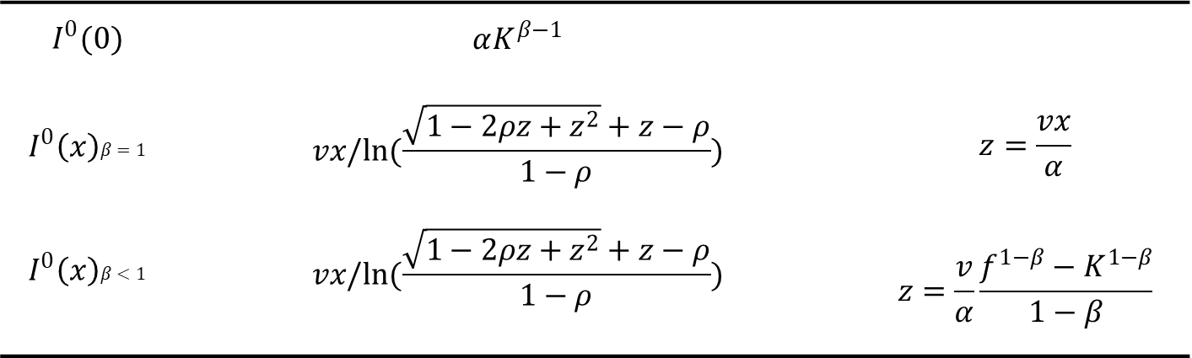


Smart Parameters System Scheme
$$I^{0} ≔I^{0}(x)$$
$$x=ln(\frac{f}{K})$$
(3)
$$I^{0}(0)$$ | $$αK^{β−1}$$
$$I^{0}\left(x\right)β=1$$ | $$vx/ln(\frac{\sqrt{1−2ρz+z^{2}}+z−ρ}{1−ρ})$$ | $$z=\frac{vx}{α}$$
$$I^{0}\left(x\right)β<1$$ | $$vx/ln(\frac{\sqrt{1−2ρz+z^{2}}+z−ρ}{1−ρ})$$ | $$z=\frac{v}{α}\frac{f^{1−β}−K^{1−β}}{1−β}$$
(4)
(5)
$$I^{1}\left(x\right)=\frac{{\left(β−1\right)}^{2}α^{2}}{24{\left(fK\right)}^{1−β}}+\frac{ρναρ}{4{\left(fK\right)}^{(1−β)/2}}+\frac{2−3ρ^{2}}{24}ν^{2}$$
$$σ_{SABR}\left(α, β,ν,ρ, K, f, T\right)=I^{0}\left(1+I^{1}T\right)$$

Slide 15
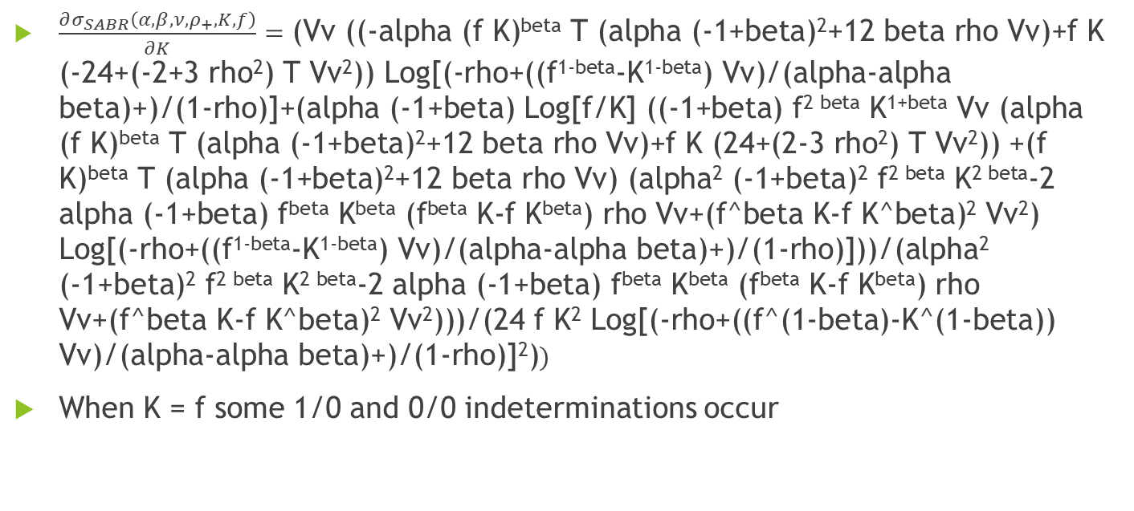

Computing (2.1) using (5) $(β<1$)
$\frac{∂σ_{SABR}\left(α, β,ν, ρ_{+}, K, f\right)}{∂K}=\text{(}\text{Vv}\text{ ((-}\text{alpha}\text{ (}\text{f} \text{K}\text{)}\text{beta} \text{T}\text{ (}\text{alpha}\text{ (-1+}\text{beta}\text{)2+12 }\text{beta} \text{rho} \text{Vv}\text{)+}\text{f} \text{K}\text{ (-24+(-2+3 }\text{rho}\text{2}\text{) }\text{T} \text{Vv}\text{2}\text{)) }\text{Log}\text{[(-}\text{rho}\text{+((}\text{f}\text{1-}\text{beta}\text{-}\text{K}\text{1-}\text{beta}\text{) }\text{Vv}\text{)/(}\text{alpha}\text{-}\text{alpha} \text{beta}\text{)+)/(1-}\text{rho}\text{)]+(}\text{alpha}\text{ (-1+}\text{beta}\text{) }\text{Log}\text{[}\text{f}\text{/}\text{K}\text{] ((-1+}\text{beta}\text{) }\text{f}\text{2 }\text{beta} \text{K}\text{1+}\text{beta} \text{Vv}\text{ (}\text{alpha}\text{ (}\text{f} \text{K}\text{)}\text{beta} \text{T}\text{ (}\text{alpha}\text{ (-1+}\text{beta}\text{)2+12 }\text{beta} \text{rho} \text{Vv}\text{)+}\text{f} \text{K}\text{ (24+(2-3 }\text{rho}\text{2}\text{) }\text{T} \text{Vv}\text{2}\text{)) +(}\text{f} \text{K}\text{)}\text{beta} \text{T}\text{ (}\text{alpha}\text{ (-1+}\text{beta}\text{)2+12 }\text{beta} \text{rho} \text{Vv}\text{) (}\text{alpha}\text{2}\text{ (-1+}\text{beta}\text{)2 }\text{f}\text{2 }\text{beta} \text{K}\text{2 }\text{beta}\text{-2 }\text{alpha}\text{ (-1+}\text{beta}\text{) }\text{fbeta} \text{Kbe}\text{ta}\text{ (}\text{fbeta} \text{K}\text{-}\text{f} \text{Kbeta}\text{) }\text{rho} \text{Vv}\text{+(}\text{f}\text{^}\text{beta} \text{K}\text{-}\text{f} \text{K}\text{^}\text{beta}\text{)2 }\text{Vv}\text{2}\text{) }\text{Log}\text{[(-}\text{rho}\text{+((}\text{f}\text{1-}\text{beta}\text{-}\text{K}\text{1-}\text{beta}\text{) }\text{Vv}\text{)/(}\text{alpha}\text{-}\text{alpha} \text{beta}\text{)+)/(1-}\text{rho}\text{)]))/(}\text{alpha}\text{2}\text{ (-1+}\text{beta}\text{)2 }\text{f}\text{2 }\text{beta} \text{K}\text{2 }\text{beta}\text{-2 }\text{alpha}\text{ (-1+}\text{beta}\text{) }\text{fbeta} \text{Kbe}\text{ta}\text{ (}\text{fbeta} \text{K}\text{-}\text{f} \text{Kbeta}\text{) }\text{rho} \text{Vv}\text{+(}\text{f}\text{^}\text{beta} \text{K}\text{-}\text{f} \text{K}\text{^}\text{beta}\text{)2 }\text{Vv}\text{2}\text{)))/(24 }\text{f} \text{K}\text{2} \text{Log}\text{[(-}\text{rho}\text{+((}\text{f}\text{^(1-}\text{beta}\text{)-}\text{K}\text{^(1-}\text{beta}\text{)) }\text{Vv}\text{)/(}\text{alpha}\text{-}\text{alpha} \text{beta}\text{)+)/(1-}\text{rho}\text{)]2)})$
When K = f some 1/0 and 0/0 indeterminations occur

Slide 16


Computing (2.1) using (3) $(x=0$)
$\frac{∂σ_{SABR}\left(α, β,ν, ρ, K, f\right)}{∂K}$ = $\frac{α\left(−1+β\right)K^{−3+β} (2α(fK)β T (α (−1+β)2+12 βρv)+fK(24+(2−3 ρ2) Tv2)))}{24αfK2}$
K = f
$$\frac{−∂σ_{SABR}\left(α, β,ν,ρ, K, f\right)}{∂K}{\left.​\right|}_{K=f}=\frac{1}{24}α \left(−1+β\right)f^{−4+β} \left(2αf^{2β} T\left(α\left(−1+β\right)2+12βρv\right)+f2\left(24+\left(2−3ρ2\right)Tv2\right)\right)$$
Solving this system of equations for both rhos in leaves me with complex roots for alpha and v.

Slide 17
Smart Parameters Bounds Scheme
Choose $ν_{0}$
Choose 𝜈_0
Deduce $α$ bounds
Deduce 𝛼 bounds
Find root $α_{0}$
Find root 𝛼_0
Compute $ρ_{0}$
Compute 𝜌_0
In case of no solution, choose new $ν_{0}$
In case of no solution, choose new 𝜈_0

Slide 18
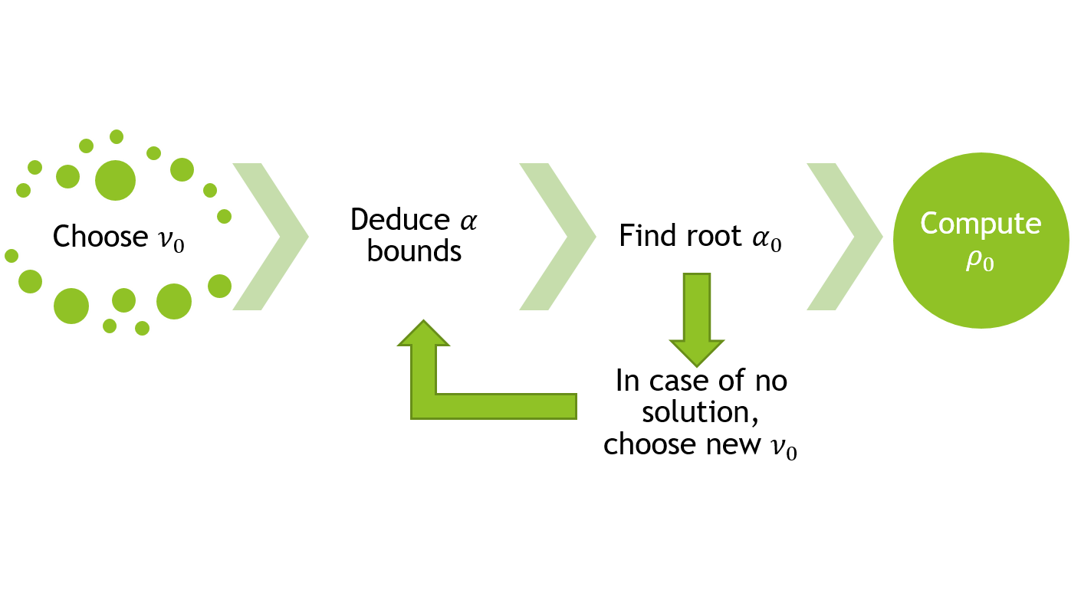
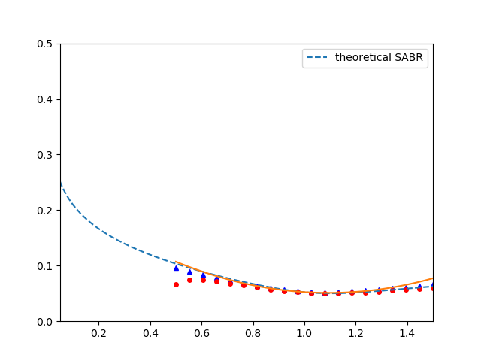
Smart Parameters
Parameter | Gen.
$$α$$ | 0.05
$$β$$ | 1
$$ρ$$ | -0.33
$$ν$$ | 0.25
T | 15
quadratic aprox ATM
European call
European put
Volatility ($σ$)
Normalized Strike ($\frac{K}{f_{0}}$)

Slide 19

Smart Parameters
Parameter | Gen.
$$α$$ | 0.05
$$β$$ | 1
$$ρ$$ | -0.33
$$ν$$ | 0.25
T | 15
quadratic aprox ATM
European call
European put
Volatility ($σ$)
$${\hat{σ}}_{ATM}$$
Normalized Strike ($\frac{K}{f_{0}}$)

Slide 20
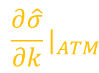
Smart Parameters
Parameter | Gen.
$$α$$ | 0.05
$$β$$ | 1
$$ρ$$ | -0.33
$$ν$$ | 0.25
T | 15
quadratic aprox ATM
European call
European put
Volatility ($σ$)
$${\frac{∂\hat{σ}}{∂k}|}_{ATM}$$
Normalized Strike ($\frac{K}{f_{0}}$)

